Slide 1
Keeping You Safe
and Feeling Happy

Slide 2
Sometimes we feel:
Scared Sad Angry Excited
Worried Happy

Slide 3
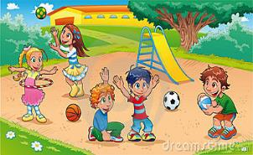
Worries can be about:
Things at home (if you don't feel safe.)
Things at school (if anyone is bothering you and spoiling your happiness.)
Things at the park, sports club or swimming pool
(if you or someone you know in
school doesn't feel safe.)
During this term we may be worried about the Coronavirus

Slide 4
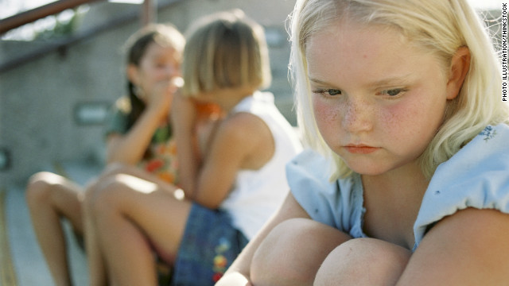
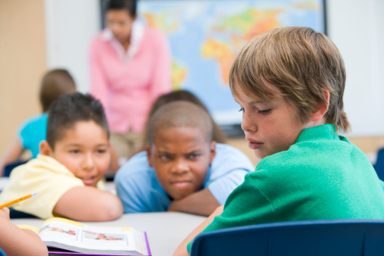
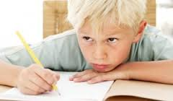
Did you know;
A problem shared is a problem halved!

Slide 5
This is What we can do when we're worried:
Talk to your class teacher
Talk to the Child Protection Teachers,
Mrs Gilchrist or Miss Grainne Smyth.
Talk to Mr Curran, our Principal.
Talk to your class teacher or classroom assistants.
Talk to your friends or family.
Put your worries in the worry box

Slide 6
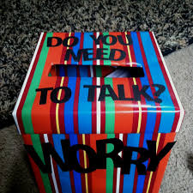
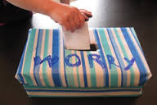
When my worries get too big!
Don’t Worry, be Happy!

Slide 7
How can we work together to keep everyone safe in school?

Slide 8
Treat everyone with RESPECT
Don't call names
Don't punch/ kick or make anyone feel sad.
Tell an adult if anyone that you know is not being nice to someone else or hurting their feelings.

Slide 9
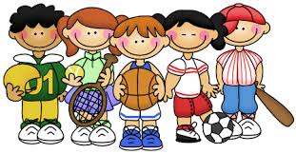
Friends
Choose sensible friends and friends that are your own age both inside and outside of school.
Be nice to your friends and value them!

Slide 10
Around School
Report anything/ anybody strange!
Hang up coats and bags - put them in a safe place!
Don't bring anything dangerous into school!
Be sensible in the toilets and give everyone their privacy!

Slide 11
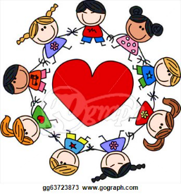
No. 1 RULE
NEVER hurt anyone
on the Inside
or the Outside

